Slide 1
CNN for Text-Based Multiple Choice
Question Answering
Authors
Akshay Chaturvedi, Onkar Pandit, Utpal Garain
Team 1
Donghwan Kim, Jeongmin Park, Michelle Foo
Notes:
our study on applied threat modeling and
enterprise environment

Slide 2
Contents
Introduction
Related works
Methodology
Experiment & Results
Conclusions

Slide 3
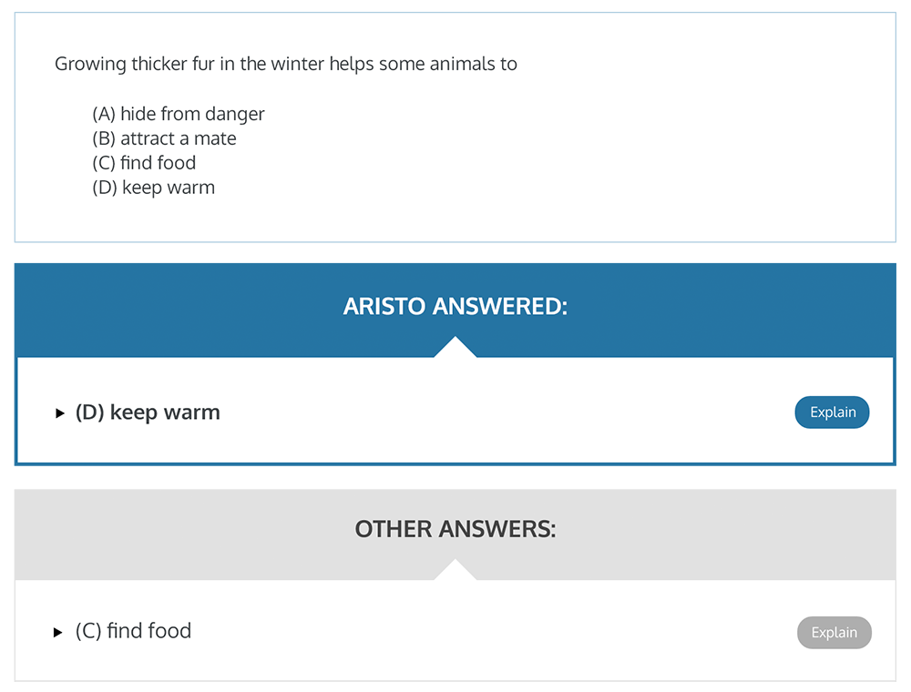
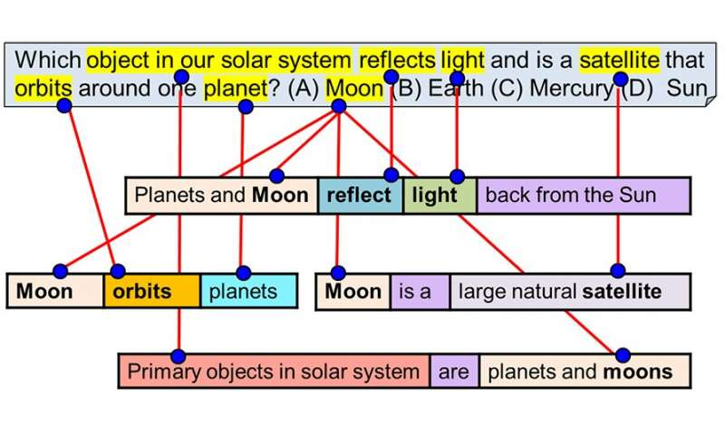
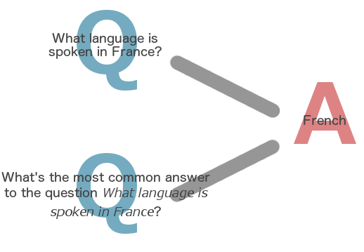
Introduction
Answering questions from text requires a diverse skill set:
Look-up
Deduce
Perform simple mathematical operations
Merge information contained in multiple sentences
This diverse skill set makes question answering difficult!

Slide 4
Related Works
Bigger datasets allowed researchers to explore different neural network architectures
Attention based models: given question based on text, model needs to pay attention to specific portion of the text in order to answer the question
CNN is shown to be effective for various NLP tasks
sentiment analysis
question classification
For Q&A, LSTM based methods are the most common
We show the effectiveness of the proposed CNN model by comparing it with several LSTM-based techniques!

Slide 5
Main Contributions
Our proposed CNN model performs comparatively/better than LSTM-based baselines on 2 different datasets (TQA, SciQ)
Our model takes question-option tuple to generate a score for the concerned option, better than considering question and option separately
We have devised a simple but effective strategy to deal with forbidden options
none of the above, both a) & b)
Our model attends at sentence level instead of word level, which helps the model during Q&A look-up

Slide 6
Methodology
Overall process
Use word2vec based query expansion followed by tf-idf score to find the most relevant paragraph
Use CNN to get a vector for each question-option pair and the most relevant paragraph.
Calculate cosine similarity of question-option pair and most relevant paragraph to find the answer option.

Slide 7

Methodology
Query Expansion

Slide 8
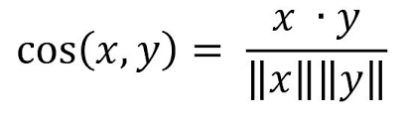
Methodology
Word2vec-based Query Expansion
Find the words that are similar to the given word in the corpus
Similarity measured by cosine similarity between word vectors.

Slide 9
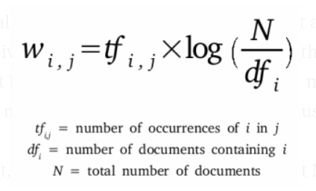
Methodology
tf-idf score
Count the number of occurrences of each word is not enough.
Common words like ‘I’, ‘the’ shouldn’t account for the similarity.

Slide 10
Methodology
Overall process
Use word2vec based query expansion followed by tf-idf score to find the most relevant paragraph
Use CNN to get a vector representation for each question-option pair and the most relevant paragraph.
Calculate cosine simliarity of question-option pair and most relevant paragraph to find the answer option.

Slide 11
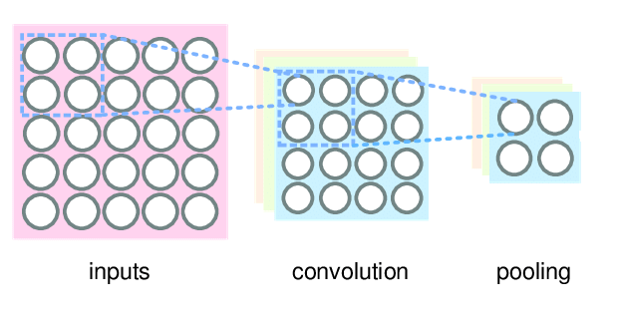
Methodology
Use CNN to get a representation of sentences
CNN consists of Convolutional layer and average pooling layer.
d dimensional word vector representation
3 kinds of kernels(e.g. CNN_{2,3,4} has d×2, d×3, d×4 sized kernels), k number of such kernels each, total 3k kernels
When Convolution is applied, we have a vector output. By applying average pooling, we have a scalar result for each kernel.
We have total 3k kernels, so the result is 3k dimensional representation of sentence.

Slide 12
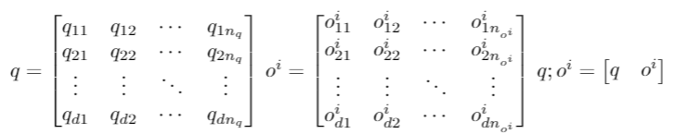


Methodology
Use CNN to get a representation of sentences
is 3k dimensional representation of (question, option) pair.
is 3k dimensional representation of j-th sentence in the most relevant paragraph.

Slide 13
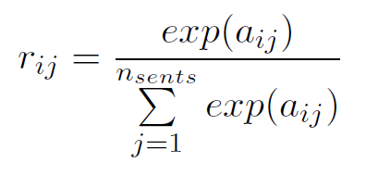
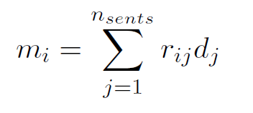
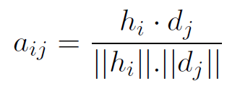
Methodology
Use CNN to get a representation of paragraph
Now we need a vector representation of most relevant paragraph.
Use a weighted combination of each sentence to get the representation.
m_i is the final representation of the paragraph

Slide 14
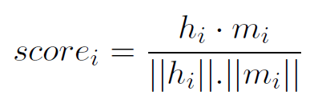
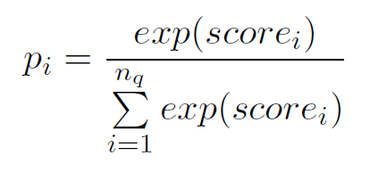
Methodology
Assign probability to each options
Use cosine similarity of (question, option) pair and paragraph as a score, and assign probability on each option using softmax function.

Slide 15

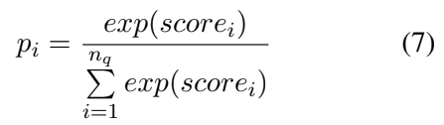
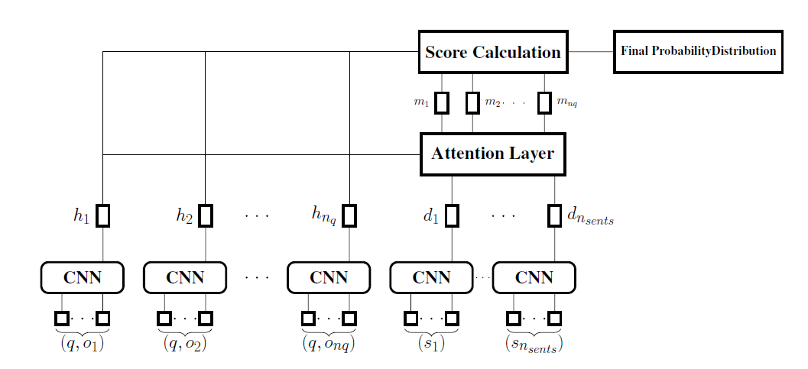
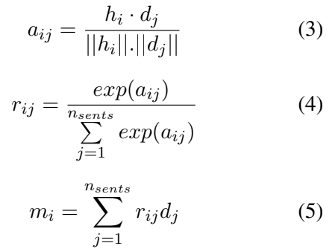


Methodology
Overview of the structure

Slide 16
Methodology
Forbidden Options
Options like ‘two of the above’ or ‘(a) or (b)’
Since we assigned score on each options, we can compare scores to make decision on these forbidden options.
For example, |score_{a} - score_{b}| < threshold leads to choose (a) or (b) option

Slide 17
Experiment & Results
SciQ dataset
Dataset made by letting the crowds to make the question for the given passage
Relatively simple, simple lookup can solve the questions
Q : What is the least-dangerous radioactive decay?
1) Alpha decay 2) Beta decay 3) Gamma decay 4) Zeta decay
All radioactive decay is dangerous to living things, but alpha decay is the least dangerous.

Slide 18
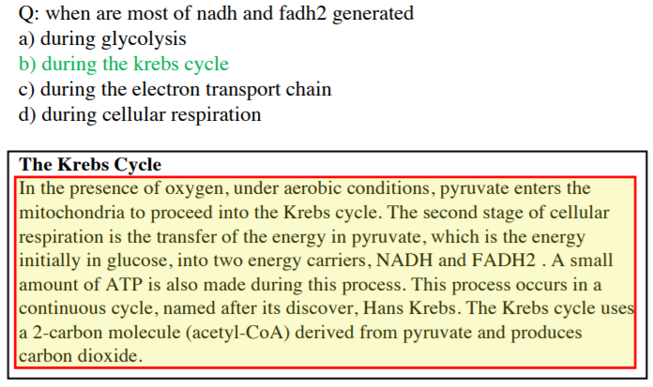
Experiment & Results
TQA dataset
Dataset drawn from middle school science curricula
Most questions cannot be answered by simple lookup, require information from multiple sentences
Also, forbidden option exists in the option.

Slide 19
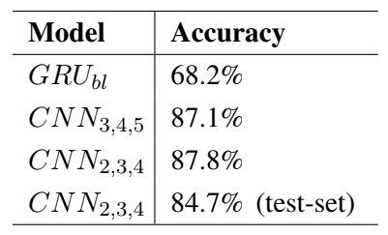
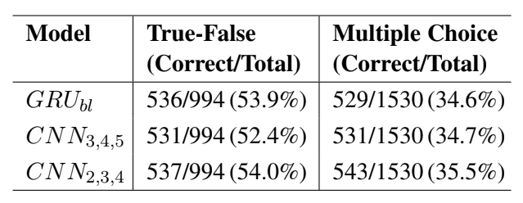
Experiment & Results
Accuracy #1
SciQ dataset
CNN model is compared to GRU_{bl} model
In GRU_{bl}, CNN is replaced by Gated Recurrent Unit (GRU) to embed question-option tuples and sentences
GRU with attention mechanism got 74.1% accuracy on the SciQ test set
However, it is not judicious to compare the two models because of different corpus
TQA dataset

Slide 20
Experiment & Results
Accuracy #1
SciQ dataset
CNN_{2,3,4} gives the best performance on the validation set of both the datasets
Why?
GRU_{bl} highly overfits on the SciQ dataset
CNN-based models work better for those datasets where long-term dependency is not a major concern
CNN_{3,4,5} had similar problem
TQA dataset

Slide 21
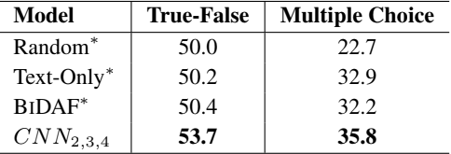
Experiment & Results
Accuracy #2
TQA dataset
Three baselines models are different as:
Rely on word-level attention
Encode questions and options separately
Text-Only model is a variant of Memory network where the paragraph, question, and options are embedded separately using LSTM followed by attention mechanism
In BIDAF model, character and word level embedding is used to encode the question and the text followed by bidirectional attention mechanism

Slide 22
Experiment & Results
Accuracy #2
TQA dataset
CNN_{2,3,4} model shows significant
improvement over the baseline models
CNN_{2,3,4} model >>> Text-Only model
because:
Sentence level attention, which worked well with single sentence answer
Question-Option tuple, which simplified comparison between two embeddings
Forbidden options, which applied special rules to counter those options

Slide 23
Experiment & Results
Forbidden Option
SciQ dataset didn’t have any questions with forbidden options
In TQA(validation set), 433 out of 1530 multiple choice questions had forbidden options
CNN_{2,3,4} with threshold strategy had 43.4% accuracy, while vanilla CNN_{2,3,4} had 25.2% accuracy
Our threshold strategy for the forbidden option works well!

Slide 24
Conclusion
This CNN model is more effective than several LSTM baselines
because:
Proposed a strategy for dealing with forbidden options
Used question-option tuple as input
However, there is a lot of scope for future work
because:
This CNN model doesn’t work well when a question requires complex deduction
E.g. ”How much percent of parent isotope remains after two half-lives?”
Answering this question using the definition requires understanding the definition and transforming the question into a numerical problem

